Slide 1
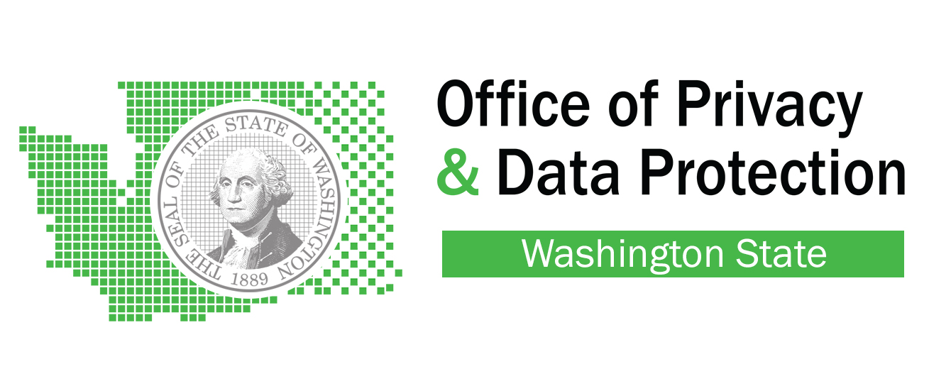
Privacy-- Annual Records Management Day
March 20, 2017
Alex Alben & Will Saunders
Office of Privacy & Data Protection
Washington
Notes:
Teach employees to be aware of privacy, know the laws, and practices to protect citizen’s privacy.

Slide 2
We love technology . . .
“Cayla is verboten in Deutschland.”
Jochen Homann, president of German’s Federal Network Agency
Feb. 17, 2017
"Can I tell you a secret?"
Reply: "Sure go ahead; be very quiet, though. I promise not to tell anyone; it's just between you and me because we are friends."
My Friend Cayla

Slide 3
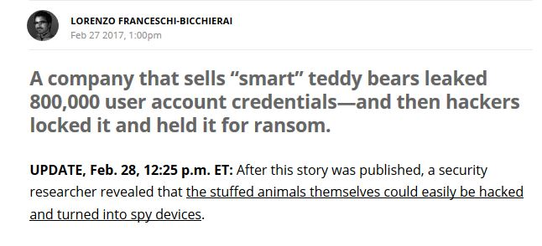

Slide 5
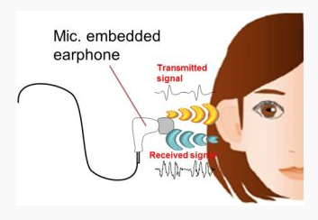
Scary statistics
5.6 million fingerprints compromised in OPM data breach
MasterCard testing “heartbeat” identification for purchases
90% of concert goers identified through facial recognition
FBI has scanned 117 million facial images of American adults
350 million images uploaded to Facebook each day– but they promise to obtain “Affirmative express consent” before using for ID.
Ear-scan technology developed by NEC

Slide 6
Washington is already using biometric identifiers
Enhanced drivers license
Fingerprints
Background checks
Iris photography

Slide 7
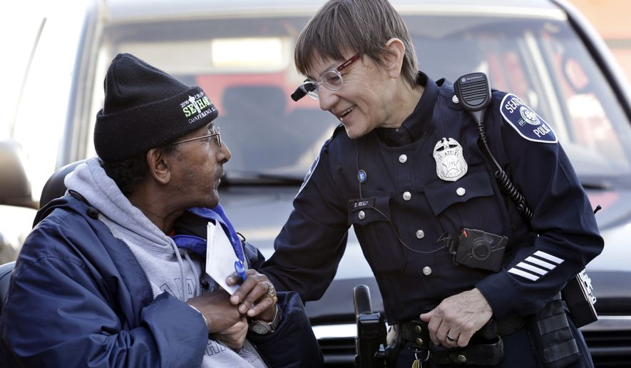
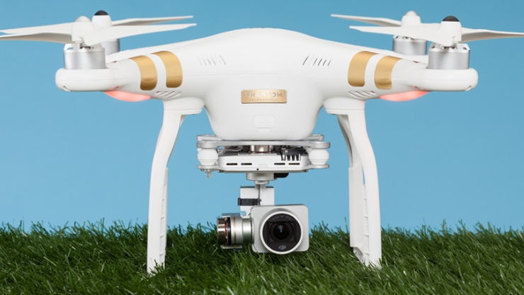
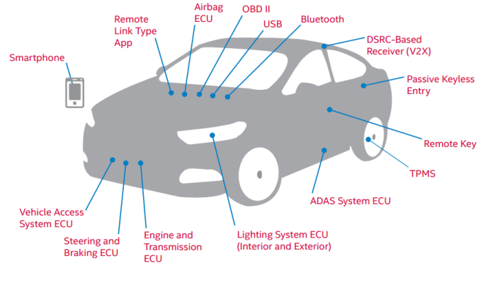
Data and Surveillance
Drones
Body Cameras
Automobiles
Traffic cameras
License plate readers
Notes:
Break into two slides 1: tech in the workplace (CCTV, Drug testing, email monitoring), 2: this slide “New Technologies”
-image, find dystopian pic for workplace

Slide 8
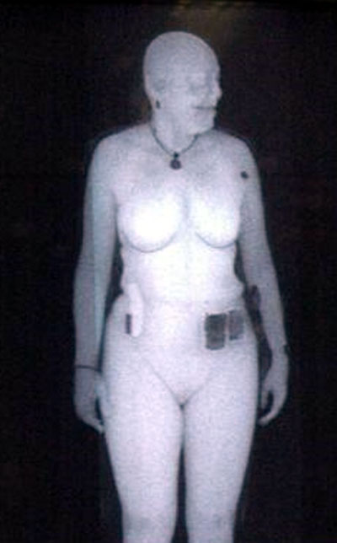
Bionic Eyes
Image of Susan Hallowell
Director of TSA’s research lab taken with backscatter x-ray system
What is a “Reasonable Expectation of Privacy?”

Slide 9
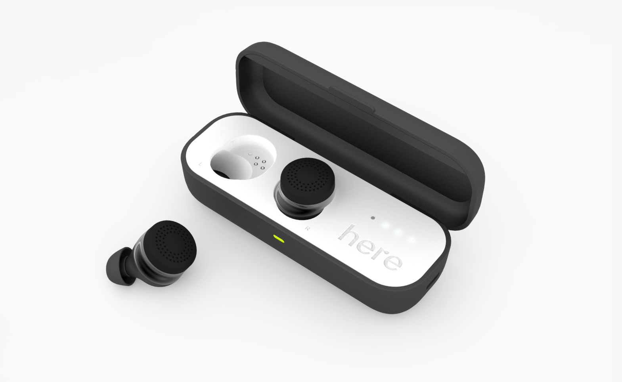
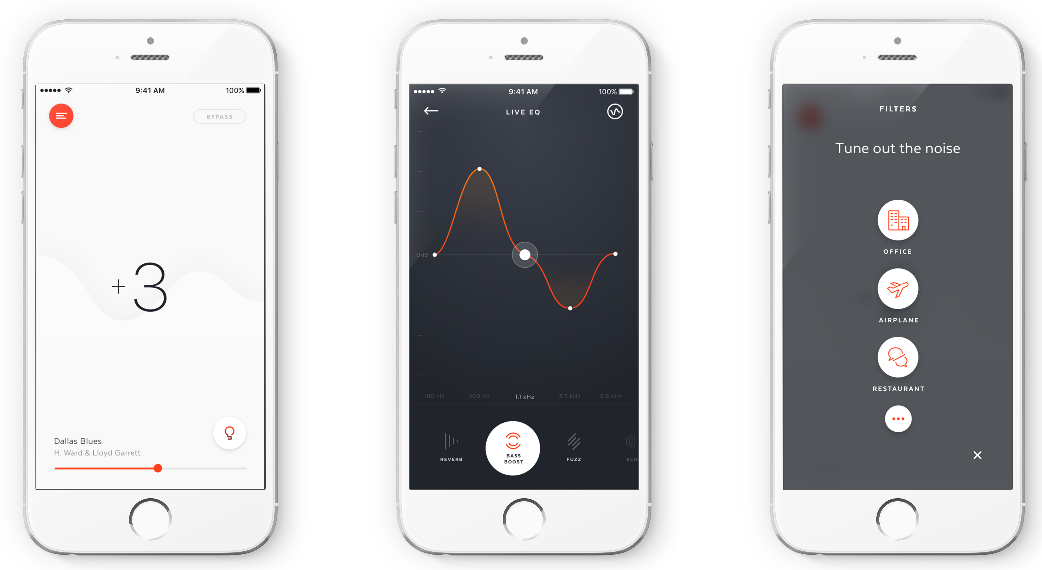
Bionic Ears
Reasonable Expectation of Privacy?????

Slide 10
State Initiatives: I. Privacy Modeling
Build privacy into product design
First of a kind web application
Draws on Federal and WA state law
Open and extensible architecture
Funded by Hewlett Foundation grant

Slide 11
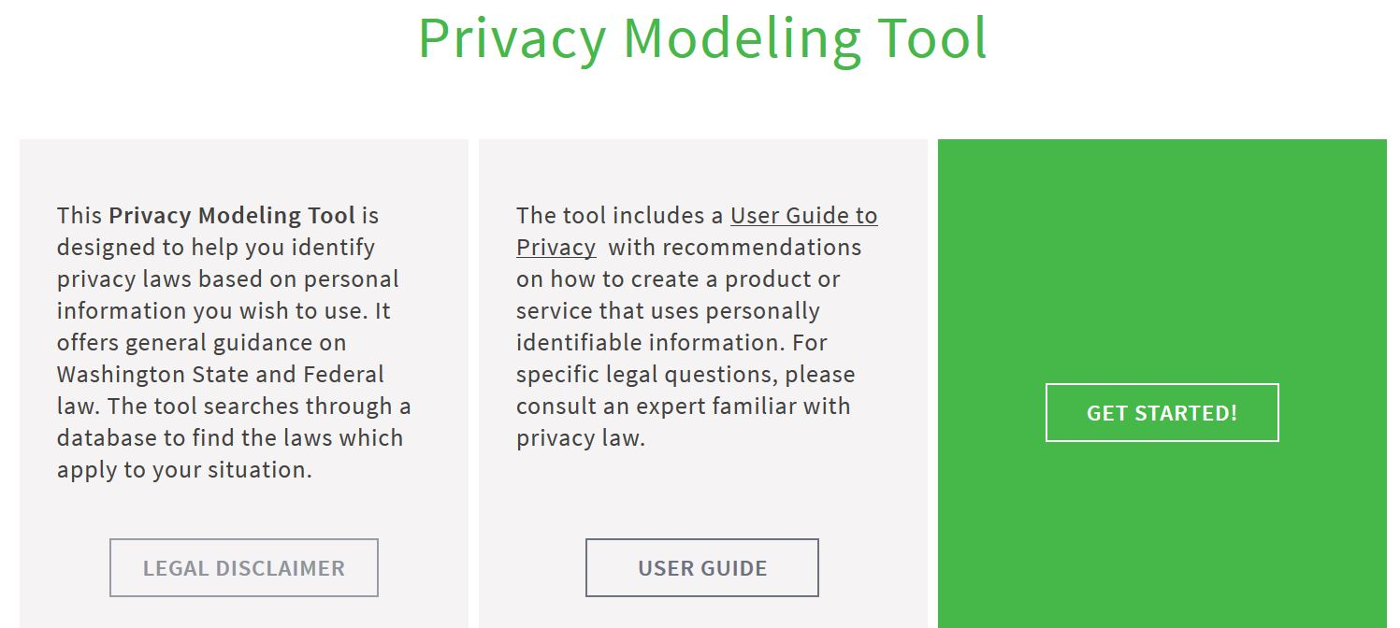

Slide 12
II. Privacy Training and Best Practices
Minimization
Training
Privacy Policy
Data Sharing Agreements
Breach Response
Encryption
De-Duplication
Privacy Impact Assessment
Records Center / Archive
Privacy Modeling
Design
Collect
Process
Store
Share
Use
Retain
Delete
Notes:
“we are moving from an era of notice meeting req.’s to where notice is not sufficient.”
Screenshot access washington policy

Slide 13
III. Privacy Assessment
Privacy questionnaire for state agencies will lead to report on state privacy practices
A strong majority rank privacy as a high priority
Agencies want more training and coordination
Agencies collect a range of data, depending on mission
Agencies use multiple tools to manage data
Agencies share private data by agreement; public data openly

Slide 14
IV. Consumer Education
Visit:
Privacy.wa.gov
Privacy guide

Slide 15
A few words on Open Data

Slide 16
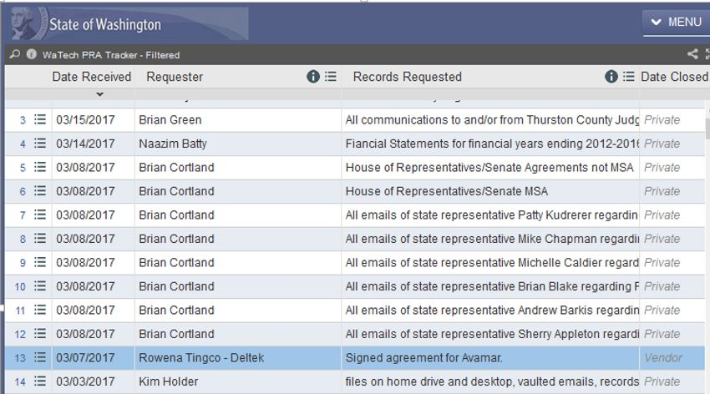

Slide 17
Alex Alben alex.alben@watech.wa.gov Will Saunders will.saunders@watech.wa.gov
To view our Privacy Guide for Washington Citizens:
Privacy.wa.gov

